Slide 1
GDES-3081-501 - Intro to Design Management
April 5ᵗʰ, 2026
tokentrust
From Data Ownership to Data Economy
A Regulatory and Operational Blueprint for tokentrust
Term Project Phase II
New Value Creation and Consumption Models in Virtual Worlds
Michael Joongmin Park
Industrial Design
#3187413
Jaehong Hwang
Graphic Design
#3191183
Elsie Jang
Graphic Design
#3197476
Group 14

Slide 2
GDES-3081-501 - Intro to Design Management
April 5ᵗʰ, 2026
Introduction & Background
03-07
Operational blueprint within Canada's regulatory framework
Value Axis I: Data Traceability
08-10
Establishing measurable data worthiness and tracking
Value Axis II & III: Value Management
11-14
Circular token economy and unified value flow
Value Axis IV: Holistic Regulation
15-17
Reframing compliance as foundational infrastructure
18-21
Strategic Roadmap
Phased governance expansion across three horizons
22-31
Governance & Stakeholder Matrix
Internal accountability (RACI Framework) and external ecosystem mapping
32-33
Conclusion & Wayfinding
Works Cited
34
Table of Contents
02

Slide 3
GDES-3081-501 - Intro to Design Management
April 5ᵗʰ, 2026
Phase I
GDPR - EU’s comprehensive data privacy law
In Phase 1, we explored the global regulatory landscape and the potential of token economics, and established TokenTrust as a proposed solution within that framework.
"Where does our data go?"
Beyond a simple exchange mechanism, position AI token commerce as the infrastructure for cross-platform value transfer.
Introduction
03

Slide 4
GDES-3081-501 - Intro to Design Management
April 5ᵗʰ, 2026
Phase II
PIPEDA - Canadian federal law on private-sector personal data
Canada-specific regulatory path defined Compliance infrastructure mapped Concept becomes operational blueprint
"Who owns the value it creates?"
A concrete pathway to operationalize tokentrust within Canada's regulatory framework.
Introduction
04

Slide 5
GDES-3081-501 - Intro to Design Management
April 5ᵗʰ, 2026
Who owns the value created from our data in virtual environments?
"We now know data has value. But the systems that capture that value were never designed to return it. In digital and virtual environments, this asymmetry only compounds. That's the gap we're closing.
Introduction
05

Slide 6
GDES-3081-501 - Intro to Design Management
April 5ᵗʰ, 2026
AI Interplatform Services Already Exist,
OpenRouter, Perplexity, Cursor, Copilot...
But you have
No control over your data.
Tokentrust is about value flow, rather than service accessibility.
Introduction
06

Slide 7
GDES-3081-501 - Intro to Design Management
April 5ᵗʰ, 2026
tokentrust ensures
sustainable value
through data ownership
Introduction
07

Slide 8
GDES-3081-501 - Intro to Design Management
April 5ᵗʰ, 2026
Data Traceability
Data Refund & Compensation
Interplatform Value Management
Holistic Regulatory Alternative
Value Axes
tokentrust
Introduction
08

Slide 9
GDES-3081-501 - Intro to Design Management
April 5ᵗʰ, 2026
Data Traceability
In today's AI ecosystem, user data becomes untraceable the moment it is submitted.
Value Axis I: Data Traceability
09

Slide 10
GDES-3081-501 - Intro to Design Management
April 5ᵗʰ, 2026
Accuracy | Completeness | Consistency | Freshness
DQI is not a quality metric.
Not only data quality assessment, but also Tracking Infrastructure
Traceability infrastructure
In the current AI ecosystem, user data becomes untraceable the moment it is submitted. DQI assigns measurable identity to data through four dimensions: Accuracy, Completeness, Consistency, and Freshness. Measurable data carries traceable value. Without traceability, no refund, no compensation, no accountability.
Value Axis I: Data Traceability
10

Slide 11
GDES-3081-501 - Intro to Design Management
April 5ᵗʰ, 2026
Data Refund & Compensation
In current virtual environments, consumption is a one-way model where users spend tokens to access a service and that is the end of it.
Value Axis II: Data Refund & Compensation
11

Slide 12
GDES-3081-501 - Intro to Design Management
April 5ᵗʰ, 2026
Use → Deplete
Use → Refund → Recirculate
Where does your value go after you spend it?
Refund & Compensation Logic
Existing AI token economies operate on a one-way consumption model: tokens are spent, value is depleted, and the user retains nothing. TokenTrust introduces a circular model where data contribution is evaluated through DQI, compensated via Reward Token, converted into Data Credit, and reinvested into service access. Refund does not exist anywhere in the current AI token market. TokenTrust makes it structural.
Value Axis I: Data Traceability
12

Slide 13
GDES-3081-501 - Intro to Design Management
April 5ᵗʰ, 2026
Interplatform Value Management
Existing platforms aggregate services. TokenTrust consolidates value. Like VISA unified payments across banks, we unify token value across AI platforms. Your data doesn't lose worth when it moves.
Value Axis III: Interplatform Value Management
13

Slide 14
GDES-3081-501 - Intro to Design Management
April 5ᵗʰ, 2026
Aggregate services
Consolidates value
Why TokenTrust, rather than other AI interplatforms?
Unified Value Flow
Existing interplatform models unify service access across AI providers. They move data, not value. TokenTrust functions as the value consolidation layer: a unified exchange infrastructure where tokens carry measurable worth across platforms, are priced by demand, and remain portable. The shift is from data pipes to value pipes.
Value Axis I: Data Traceability
14

Slide 15
GDES-3081-501 - Intro to Design Management
April 5ᵗʰ, 2026
Holistic Regulatory Alternative
Regulation is not a cost of compliance, but a prerequisite for value creation.
Value Axis IV: Holistic Regulatory Alternative
15

Slide 16
GDES-3081-501 - Intro to Design Management
April 5ᵗʰ, 2026
Risk & Penalty
Service Foundation
Regulation activates the other three axes.
Regulation-Driven Value
Every competitor in the AI regulatory compliance market operates from a penalty avoidance perspective. TokenTrust reframes compliance as user reward. PIPEDA, FINTRAC, CBPR, and ISO/IEC 42001 are not obligations to manage but infrastructure to build on. Without regulatory foundation, traceability has no legal weight, refund has no enforceable structure, and interplatform exchange has no jurisdictional legitimacy.
Value Axis I: Data Traceability
16

Slide 17
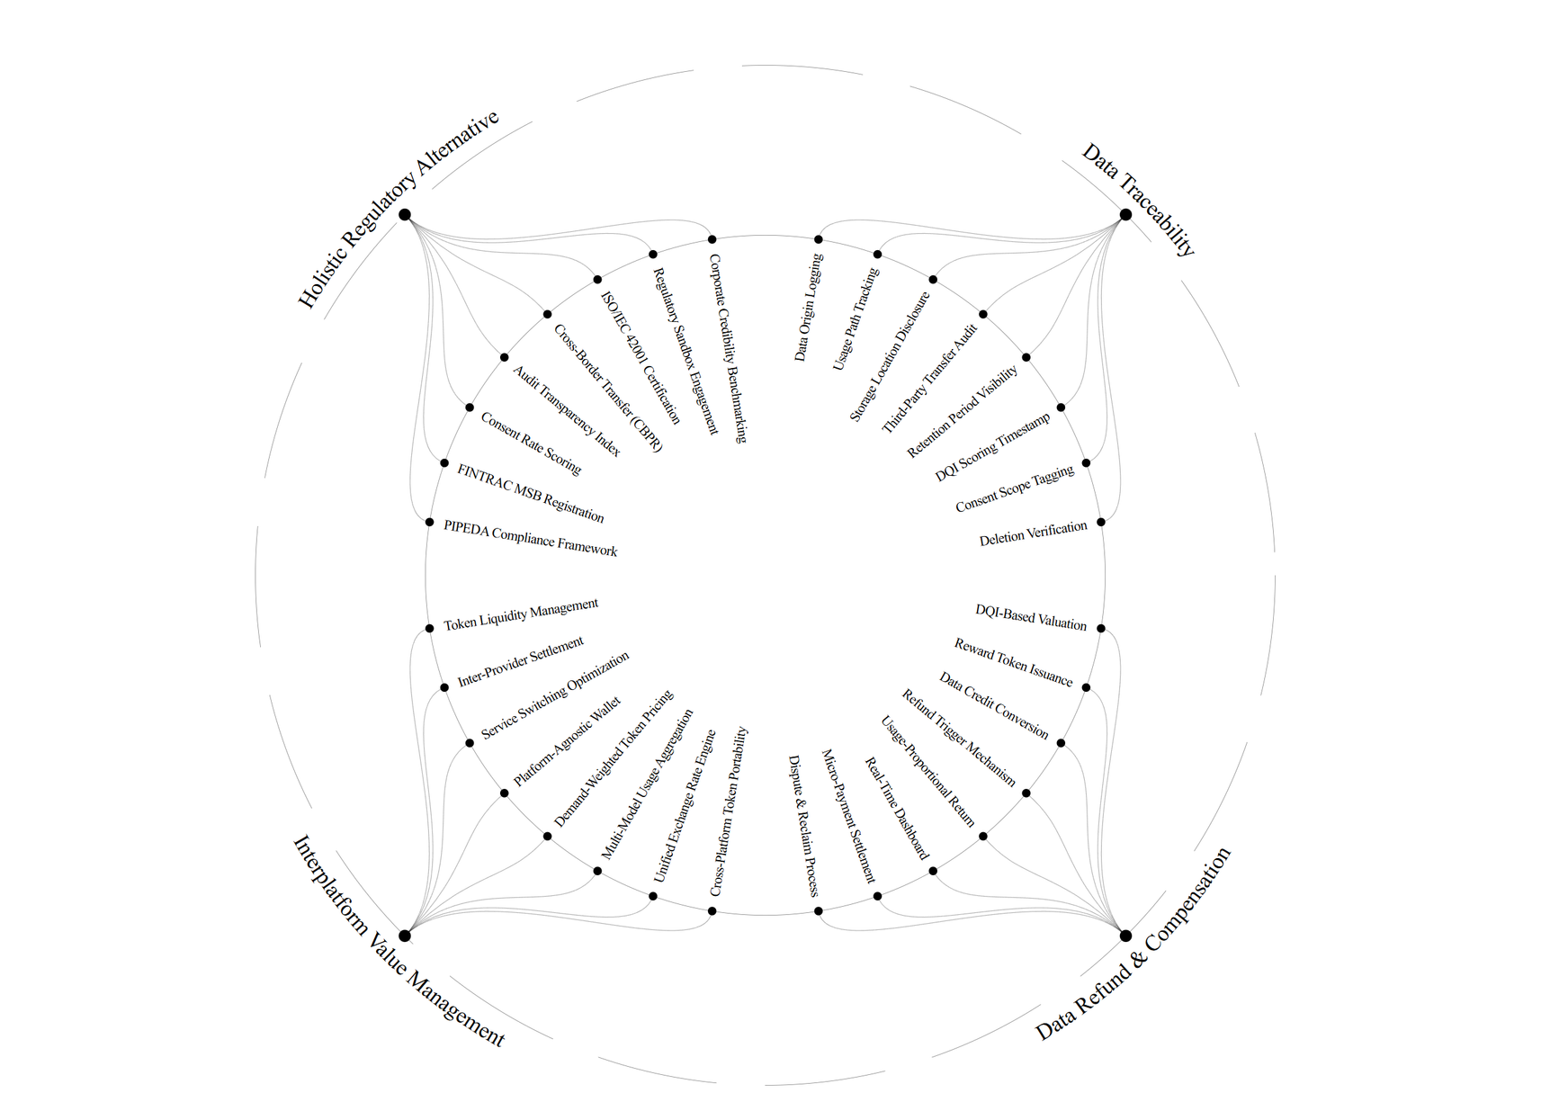
GDES-3081-501 - Intro to Design Management
April 5ᵗʰ, 2026
Value Mapping
Operational Factors
Token Economy Model
Each value axis contains eight operational factors. The connections between axes represent structural dependencies: Traceability enables Refund, Regulatory governs all axes, and Interplatform requires all three to be operational before activation.
Value Mapping
17

Slide 18
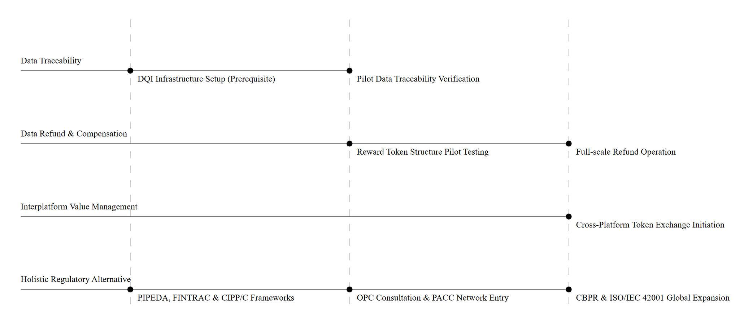
GDES-3081-501 - Intro to Design Management
April 5ᵗʰ, 2026
H - I
H - II
H - III
Strategic Roadmap Across Four Value Axes
Each value axis activates at a different horizon. Data Traceability is the earliest prerequisite, Regulatory spans all phases, Refund begins at pilot stage, and Interplatform opens only after cross-border governance is secured
Strategic Roadmap
18

Slide 19
GDES-3081-501 - Intro to Design Management
April 5ᵗʰ, 2026
H - I
Register with FINTRAC as a Money Services Business (PCMLTFA, s. 5(h))
[Present]
"Can we legally operate?"
Establish PIPEDA compliance framework & consent logging (Schedule 1, Principle 4.3)
Designate CIPP/C-certified Data Protection Officer (Principle 4.1)
Strategic Roadmap : Regulatory Body
19

Slide 20
GDES-3081-501 - Intro to Design Management
April 5ᵗʰ, 2026
H - II
Build advisory relationship with OPC (Office of the Privacy Commissioner)
[Y1–Y3]
"Who governs our governance?"
Apply for OPC regulatory sandbox for token-based data exchange
Activate PACC network for government channel access
Strategic Roadmap : Regulatory Body
20

Slide 21
GDES-3081-501 - Intro to Design Management
April 5ᵗʰ, 2026
H - III
Pursue Global CBPR certification for cross-border data transfer legitimacy
[Y3+]
"Can our data cross borders?"
Achieve ISO/IEC 42001 AI Management System certification
Establish international governance standard as TokenTrust scales globally
Strategic Roadmap : Regulatory Body
21

Slide 22
GDES-3081-501 - Intro to Design Management
April 5ᵗʰ, 2026
What regulatory infrastructure must be in place before TokenTrust can operate?
PIPEDA
CIPP/C
FINTRAC MSB
Consent
Privacy
Token
PIPEDA applies at every layer: collection, valuation, compensation, and cross-platform transfer. TokenTrust's compliance scope extends far beyond standard consent obligations.
Embedding a CIPP/C-certified professional within the compliance team ensures PIPEDA-aligned data governance from the operational level.
Token exchangeability triggers MSB classification under FINTRAC. Registration is a precondition, not an option.
Regulatory Infrastructure
22

Slide 23

GDES-3081-501 - Intro to Design Management
April 5ᵗʰ, 2026
Regulatory Alignment and Institutional Partnership
Privacy & Acess Council of Canada
Office of the privacy Commissioner of Canada
PACC
OPC provides advisory guidance on PIPEDA compliance for TokenTrust's data-token exchange model. PACC serves as a professional network for building credibility within Canada's privacy governance community. Under Phase 1, TokenTrust submits annual transparency reports to OPC and files regulatory disclosures with FINTRAC when material changes in token transaction volume occur.
Regulatory Foundation
23

Slide 24
GDES-3081-501 - Intro to Design Management
April 5ᵗʰ, 2026
International Governance
Global CBPR & ISO/IEC 42001
As TokenTrust's token ecosystem operates across AI enterprises headquartered in different jurisdictions, cross-border data transfer becomes a structural requirement. CBPR provides the legal framework for international data flow, and ISO/IEC 42001 certifies TokenTrust's AI governance standards at the global level
Regulatory Foundation
24

Slide 25
GDES-3081-501 - Intro to Design Management
April 5ᵗʰ, 2026
I
II
III
IV
Internal
Regulators
Partners
Regulated
CEO/Founder · Legal & Compliance (CIPP/C) · CTO · DPO
OPC · FINTRAC · ISED
Okta and SSI Inc. GPAI
AI Enterprises
Holds accountability for regulatory compliance execution and platform governance operations.
Sets the legal boundaries within which TokenTrust must operate and report.
Okta and SSI Inc. supply authentication and identity verification infrastructure. GPAI operates as an international policy advisory body for AI governance alignment."
AI Enterprises operate as primary institutional participants within TokenTrust's data governance and token compensation framework.
Stakeholder Definition
TokenTrust's governance operates across four layers: internal teams execute compliance, regulators set jurisdictional boundaries, partners provide technical and policy infrastructure, and AI Enterprises participate as primary clients of the token exchange ecosystem.
Stakeholder Definition
25

Slide 26
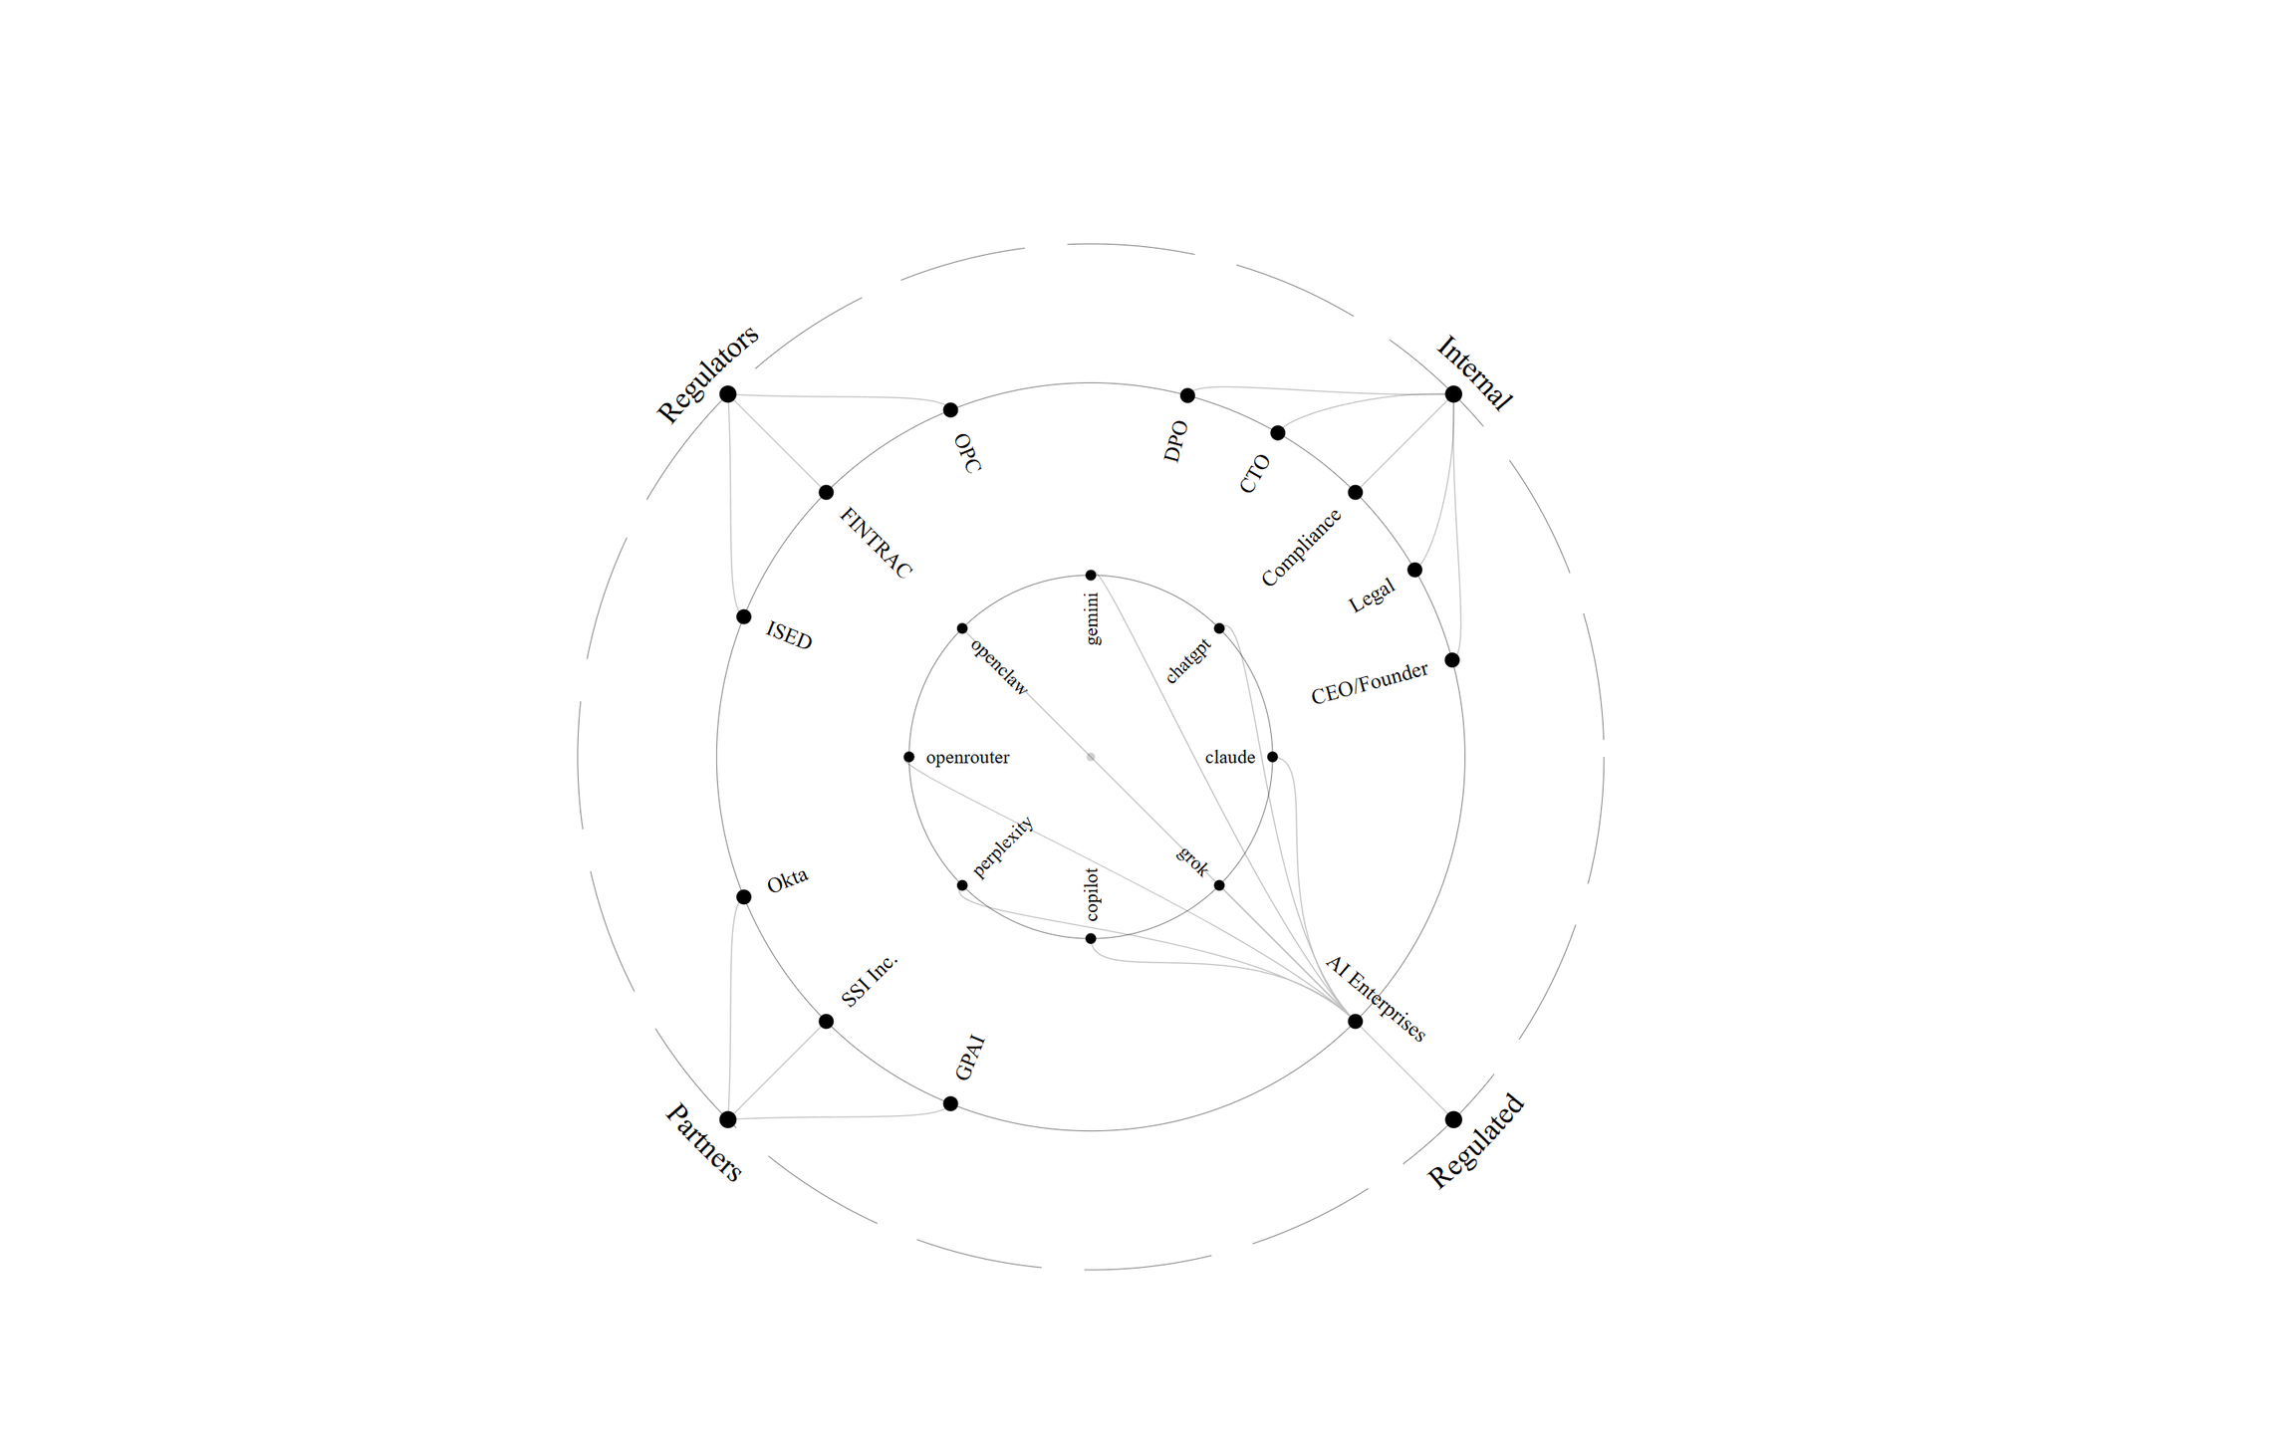
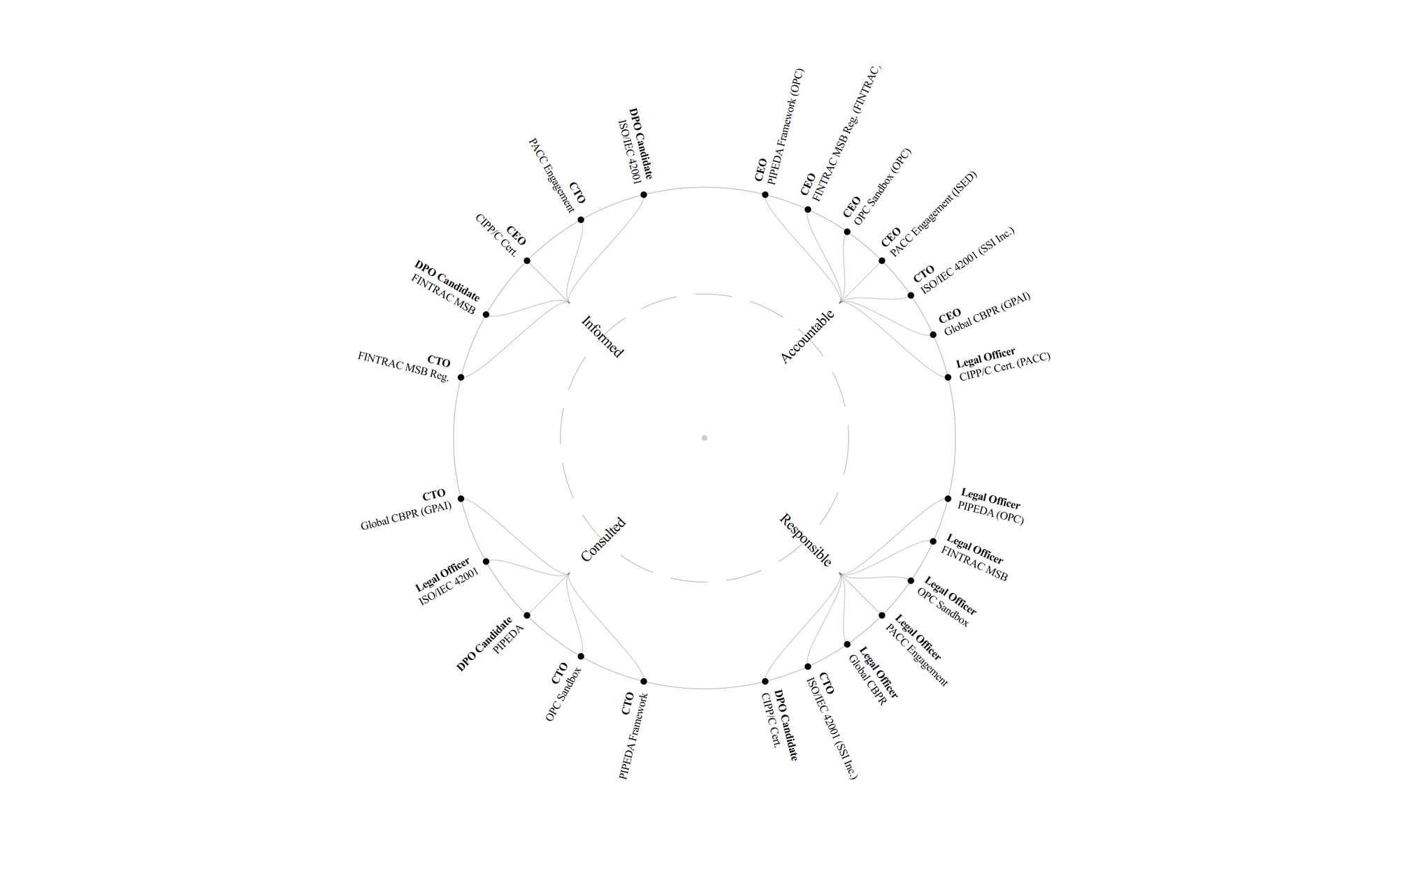
GDES-3081-501 - Intro to Design Management
April 5ᵗʰ, 2026
tokentrust
Overview
Stakeholder Mapping: Overview
26

Slide 27
GDES-3081-501 - Intro to Design Management
April 5ᵗʰ, 2026
Stakeholder Mapping
Token Economy
Speculative Virtual Environment
TokenTrust is focused on building infrastructure through strategic partnerships while working closely with Canadian regulators to ensure AI services align with the local regulatory framework, ultimately fostering an ecosystem that drives new value creation.
Stakeholder Mapping: Token Economy
27

Slide 28
GDES-3081-501 - Intro to Design Management
April 5ᵗʰ, 2026
Stakeholder Mapping
RACI Framework
Internal System
Internally, TokenTrust automates RACI-based reporting and assessment to streamline regulatory audits and data tracking. Through technical partnerships with AI enterprises, it ensures internal data flows remain secure, reliable, and fully transparent.
Stakeholder Mapping: RACI Framework
28

Slide 29
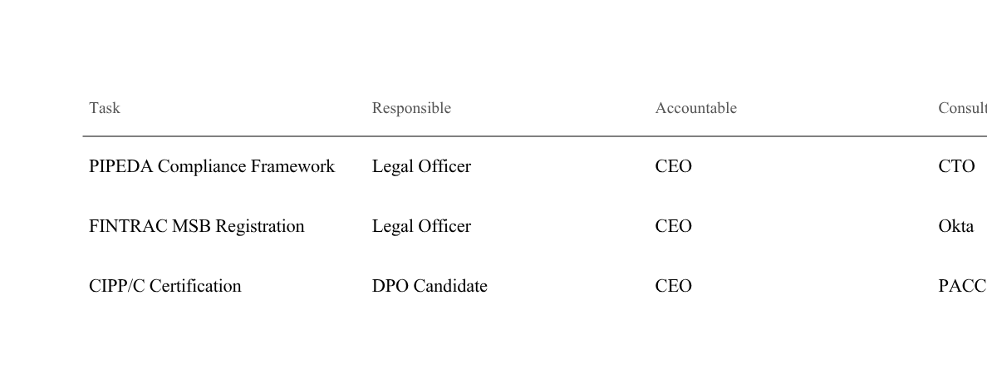
GDES-3081-501 - Intro to Design Management
April 5ᵗʰ, 2026
H - I
RACI Matrix
PIPEDA compliance requires CTO consultation because the technical architecture of the DQI-to-token pipeline directly determines what constitutes data collection under federal law. FINTRAC registration involves Okta because token authentication infrastructure defines the scope of reportable transactions.
Internal execution only. Single-entity consultation.
RACI Framework
29

Slide 30
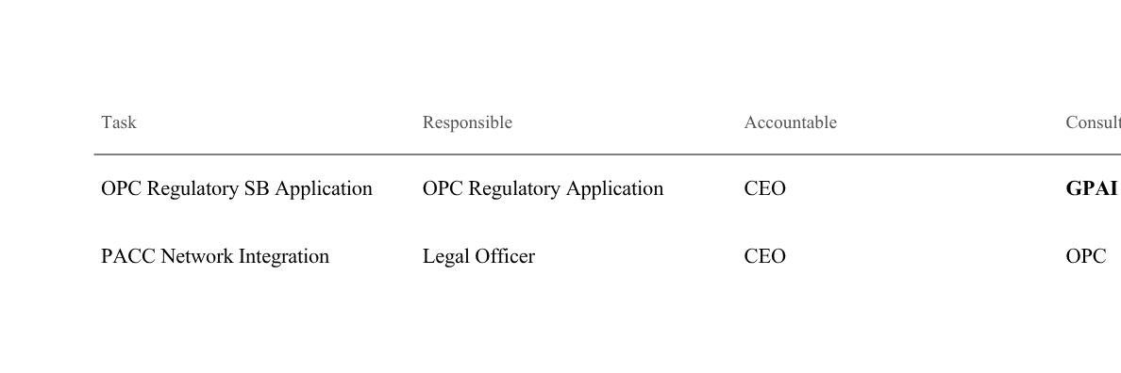
GDES-3081-501 - Intro to Design Management
April 5ᵗʰ, 2026
H - II
RACI Matrix
As TokenTrust enters pilot partnerships, GPAI is consulted for global regulatory precedent and ISED is informed to align with Canada's federal innovation policy direction.
External stakeholders enter. Pilot-stage expansion.
RACI Framework
30

Slide 31
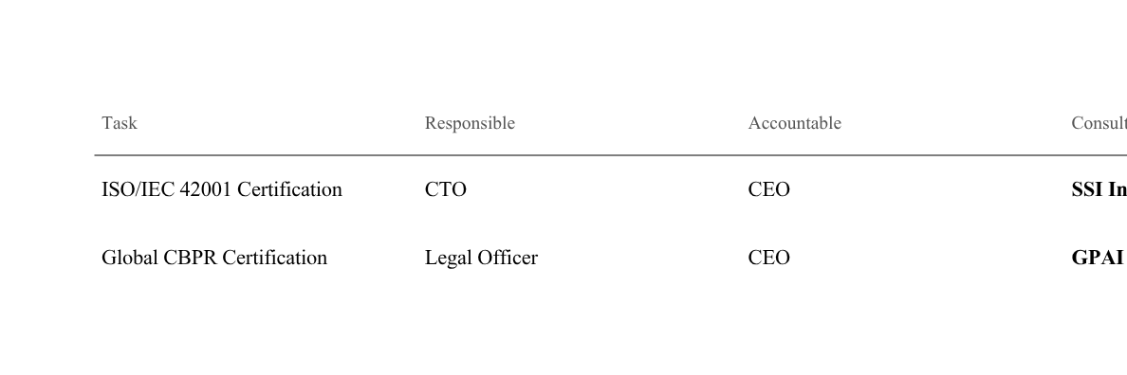
GDES-3081-501 - Intro to Design Management
April 5ᵗʰ, 2026
H - III
RACI Matrix
At full maturity, SSI Inc. and GPAI jointly advise on technical and policy standards, while AI Enterprises enter the Informed layer as direct participants in TokenTrust's cross-border token ecosystem.
Multi-entity consultation. Full ecosystem maturity.
RACI Framework
31

Slide 32
GDES-3081-501 - Intro to Design Management
March 23rd, 2026
Conclusion
From Blueprint to Operation
Phase 2 defined the regulatory foundation and accountability structure required to make TokenTrust operational — from Canadian compliance to global governance readiness.
This positions AI token commerce not merely as an exchange mechanism, but as infrastructure that requires compliance as its base layer before value can flow.
Next: Pilot operations and market validation on this regulatory infrastructure.
Conclusion
32

Slide 33
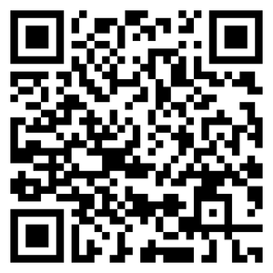
GDES-3081-501 - Intro to Design Management
April 5ᵗʰ, 2026
Interactable Design
Wayfinding in the Token Economy
Dashboard
Data Flow
Return
Settings
Token balance, value status, portfolio overview.
Destination tracking, usage path, transfer history.
Refund history, compensation records, earned value.
Privacy level control, consent boundaries, reward rate adjustment.
Each layer answers a distinct navigational question. Together, they form a complete wayfinding system that enables users to orient, trace, retrieve, and control within the token economy.
Introduction
33

Slide 34
GDES-3081-501 - Intro to Design Management
April 5ᵗʰ, 2026
tokentrust
Reference
Government of Canada. (n.d.). Personal Information Protection and Electronic Documents Act (PIPEDA). priv.gc.ca/en/privacy-topics/privacy-laws-in-canada/the-personal-information-protection-and-electronic-documents-act-pipeda/
Financial Transactions and Reports Analysis Centre of Canada. (n.d.). Money services businesses. fintrac-canafe.gc.ca/msb-esm/intro-eng
International Association of Privacy Professionals. (n.d.). Certified Information Privacy Professional/Canada (CIPP/C). iapp.org/certify/cipp/canada/
Office of the Privacy Commissioner of Canada. (n.d.). priv.gc.ca
Global CBPR Forum. (n.d.). Global Cross-Border Privacy Rules. globalcbpr.org
International Organization for Standardization. (2023). ISO/IEC 42001:2023 Artificial intelligence management system. iso.org/standard/81230.html
Works Cited
34

